Slide 1
Programming for Embedded System

Slide 2
Timing for Programs(ALP)
8051 microcontroller connected to 11.0592 MHz crystal oscillator. Find total time delay of below program. Follow past lectures Topic:Period of machine cycle.
MOV R3, #55
DEC R3
ADD A, #25

Slide 3
Timing for Programs
8051 microcontroller connected to 11.0592 MHz crystal oscillator.Find total time delay of below program
Instruction | Machine Cycle | Time to execute
MOV R3, #55 | 1 | 1.085 µs
DEC R3 | 1 | 1.085 µs
ADD A, #25 | 1 | 1.085 µs
Total time delay of the program= 1.085 µs*3= 3.225 µs

Slide 4
Timing for Programs
8051 microcontroller connected to 11.0592 MHz crystal oscillator.Find total time delay of below program
Instruction | Machine Cycle | Total Time delay: 401* 1.085=435.085 µs
MOV R3, # 200 | 1
Here: DJNZ R3, Here | 2 *200

Slide 5
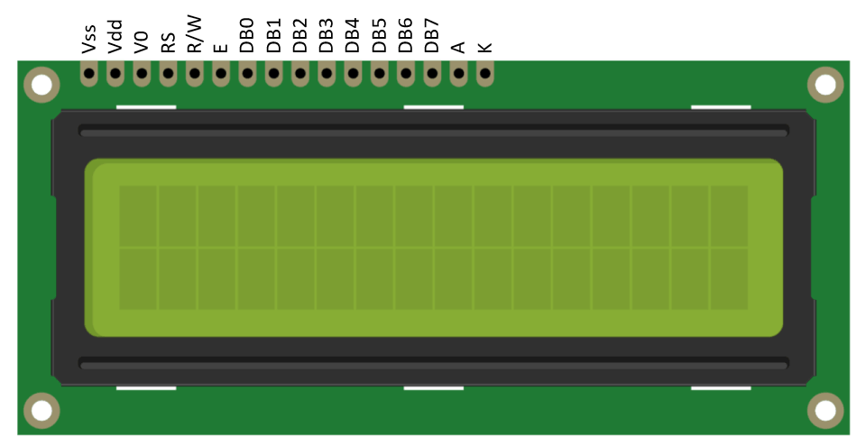
LCD Interfacing with 8051 & ALP
Pdf in Moodle

